Slide 1
Analysis of DFIG with Unbalanced Stator Voltage
M. Shamaas
2018-MS-EE-4

Slide 2
Overview
Stator Voltage Unbalance causes Positive Sequence Voltage/ Current Components and Negative Sequence Voltage/ Current Components to be disturbed. This causes unwanted Torque Pulsations.
GSC will compensate the negative sequence currents required in the network during the voltage unbalance. It also controls Power delivered to grid by GSC and DC Link Voltage.
RSC will eliminate negative sequence rotor currents, negative sequence stator currents and torque pulsation. It also controls Active and Reactive Power delivered by stator.

Slide 3
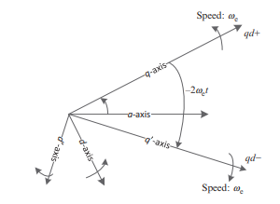
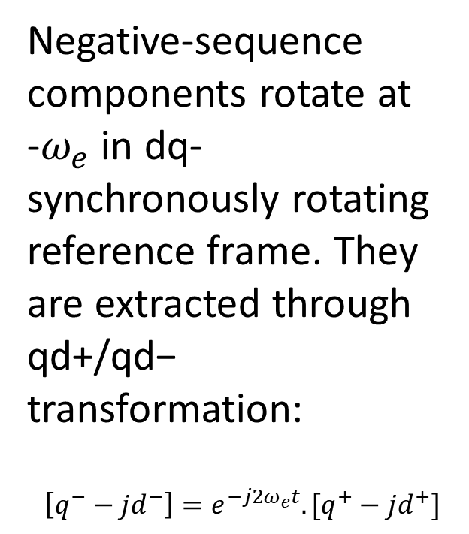
Negative Sequence dq- Components
Negative-sequence components rotate at -$ω_{e}$ in dq- synchronously rotating reference frame. They are extracted through qd+/qd− transformation:
$$\left[q^{−}−jd^{−}\right]=e^{−j2ω_{e}t}.[q^{+}−jd^{+}]$$

Slide 4
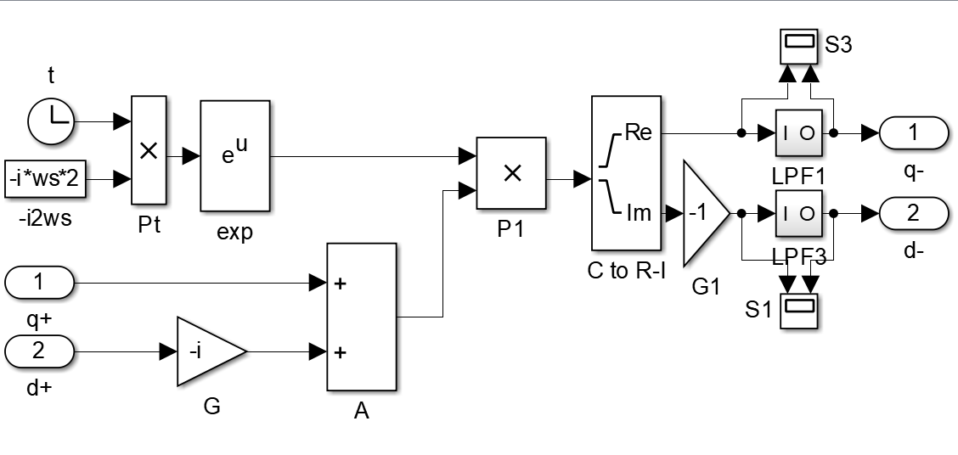
dq+/dq- Transformation

Slide 5
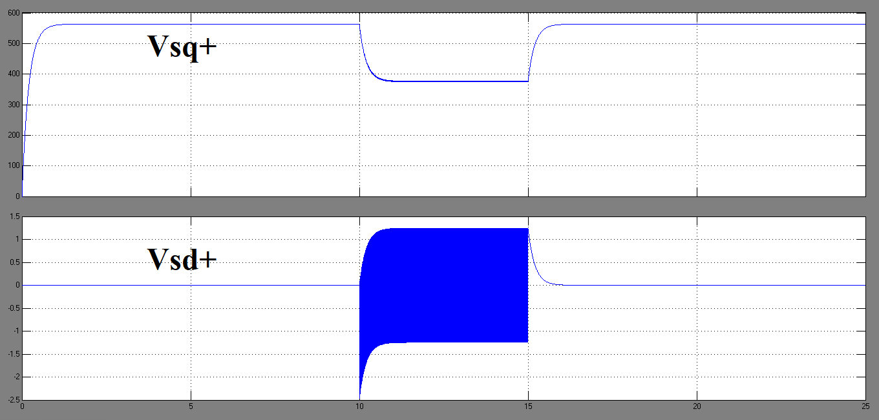
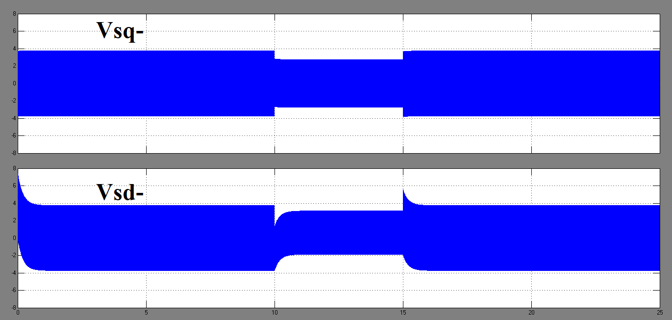
Stator Phase a Voltage Collapses to zero for t=10s to t=15s

Slide 6
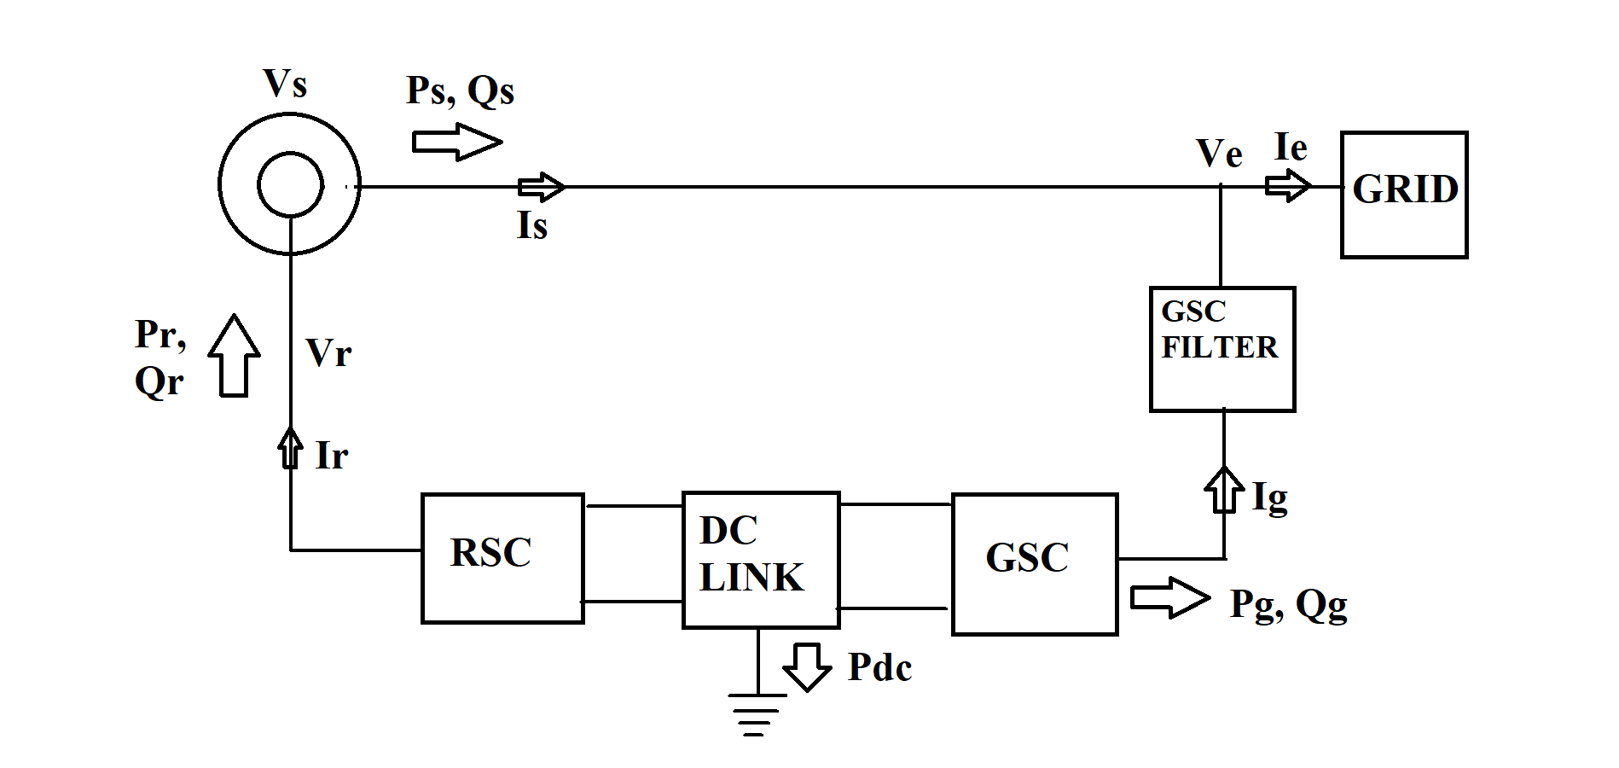
Complete DFIG Model

Slide 7
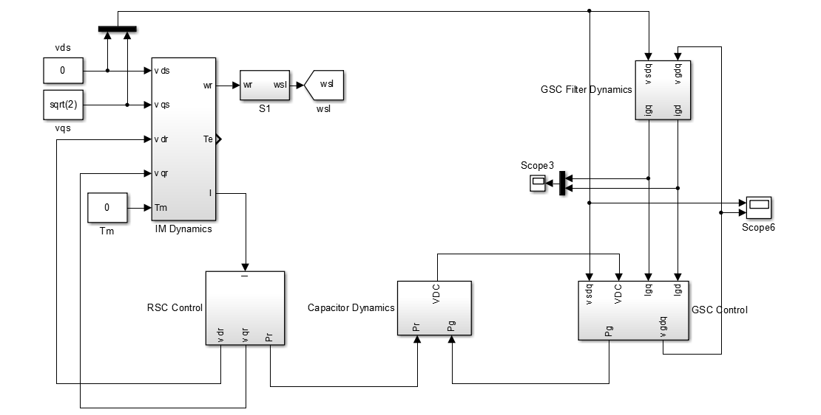
Complete DFIG Simulation Model

Slide 8
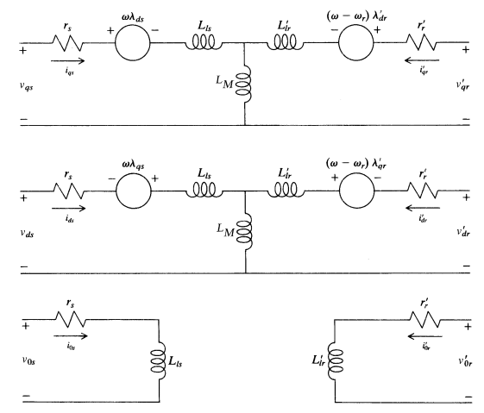
Induction Machine dq0-axis Model

Slide 9
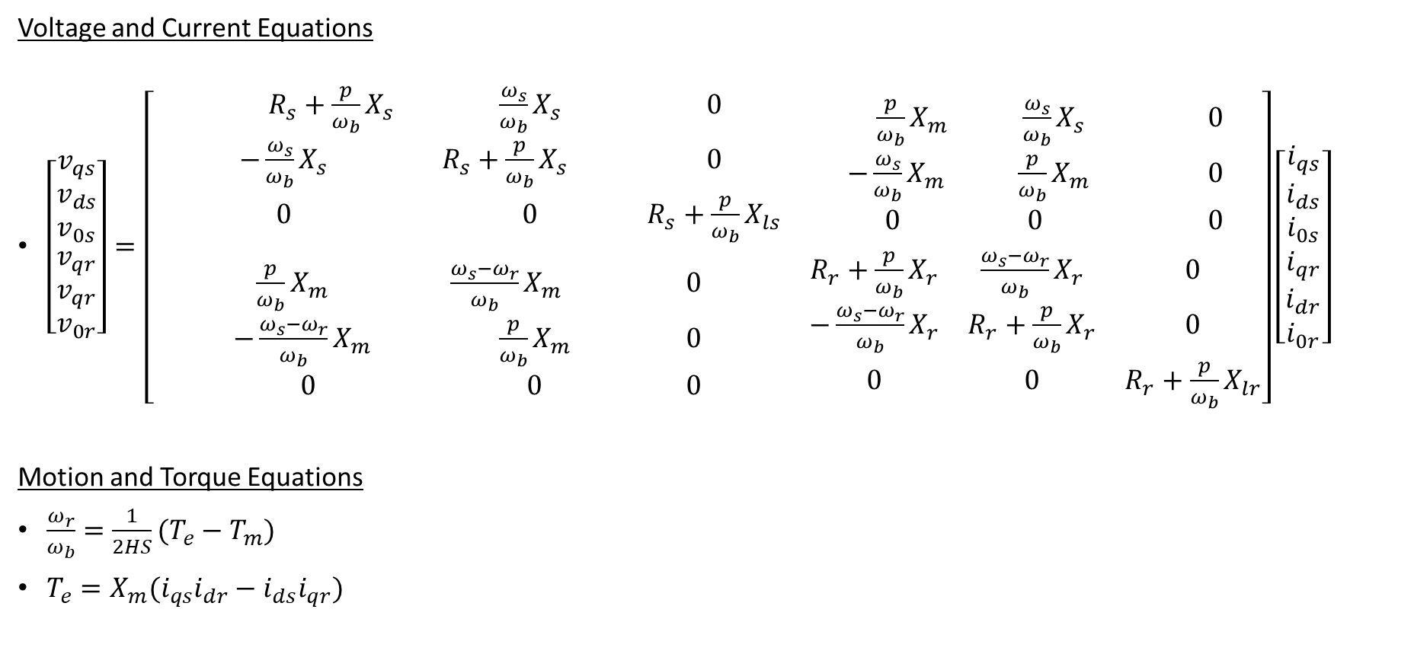
Induction Machine dq0-axis Model Equations
Voltage and Current Equations
$\left[\begin{matrix}\begin{matrix}v_{qs} \\ v_{ds} \\ v_{0s}\end{matrix} \\ \begin{matrix}v_{qr} \\ v_{qr} \\ v_{0r}\end{matrix}\end{matrix}\right]=\left[\begin{matrix}\begin{matrix} R_{s}+\frac{p}{ω_{b}}X_{s} & \frac{ω_{s}}{ω_{b}}X_{s} & 0 \\ −\frac{ω_{s}}{ω_{b}}X_{s} & R_{s}+\frac{p}{ω_{b}}X_{s} & 0 \\ 0 & 0 & R_{s}+\frac{p}{ω_{b}}X_{ls}\end{matrix} & \begin{matrix}\frac{p}{ω_{b}}X_{m} & \frac{ω_{s}}{ω_{b}}X_{s} & 0 \\ −\frac{ω_{s}}{ω_{b}}X_{m} & \frac{p}{ω_{b}}X_{m} & 0 \\ 0 & 0 & 0\end{matrix} \\ \begin{matrix}\frac{p}{ω_{b}}X_{m} & \frac{ω_{s}−ω_{r}}{ω_{b}}X_{m} & 0 \\ −\frac{ω_{s}−ω_{r}}{ω_{b}}X_{m} & \frac{p}{ω_{b}}X_{m} & 0 \\ 0 & 0 & 0\end{matrix} & \begin{matrix}R_{r}+\frac{p}{ω_{b}}X_{r} & \frac{ω_{s}−ω_{r}}{ω_{b}}X_{r} & 0 \\ −\frac{ω_{s}−ω_{r}}{ω_{b}}X_{r} & R_{r}+\frac{p}{ω_{b}}X_{r} & 0 \\ 0 & 0 & R_{r}+\frac{p}{ω_{b}}X_{lr}\end{matrix}\end{matrix}\right]\left[\begin{matrix}\begin{matrix}i_{qs} \\ i_{ds} \\ i_{0s}\end{matrix} \\ \begin{matrix}i_{qr} \\ i_{dr} \\ i_{0r}\end{matrix}\end{matrix}\right]$
Motion and Torque Equations
$\frac{ω_{r}}{ω_{b}}=\frac{1}{2HS}(T_{e}−T_{m})$
$T_{e}=X_{m}(i_{qs}i_{dr}−i_{ds}i_{qr})$

Slide 10

Induction Machine dq0-axis Model Equations
DFIG control relies on stator flux-oriented reference frame
$v_{ds}$=0
$$ѱ_{qs}=L_{s}i_{qs}+L_{m}i_{qr}=0$$
$$ѱ_{ds}=L_{s}i_{ds}+L_{m}i_{dr}=ѱ_{s}$$
$$ѱ_{qr}=L_{r}i_{qr}+L_{m}i_{qs}=\left(L_{r}−\frac{L_{m}^{2}}{L_{s}}\right)i_{qr}=σL_{r}i_{qr}$$
$$ѱ_{dr}=L_{r}i_{dr}+L_{m}i_{ds}= σL_{r}i_{dr}+\frac{L_{m}}{L_{s}}ѱ_{ds}$$

Slide 11
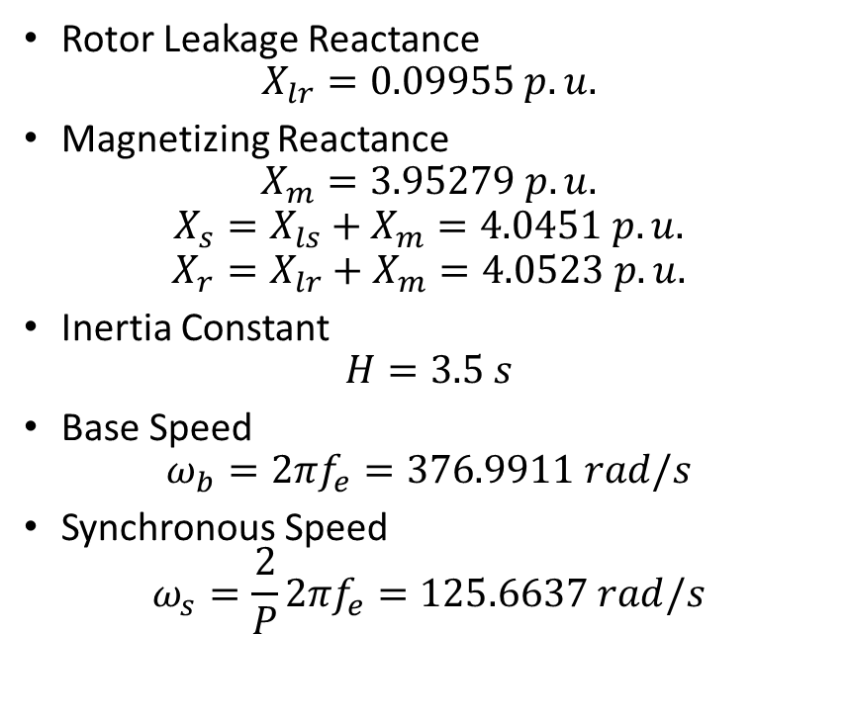
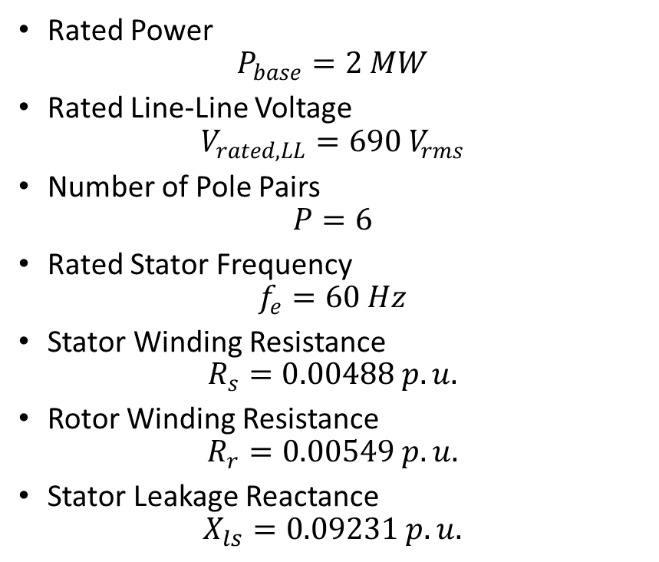
DFIG Machine Constants
Rated Power
$$P_{base}=2 MW$$
Rated Line-Line Voltage
$$V_{rated,LL}=690 V_{rms}$$
Number of Pole Pairs
$$P=6$$
Rated Stator Frequency
$$f_{e}=60 Hz$$
Stator Winding Resistance
$$R_{s}=0.00488 p.u.$$
Rotor Winding Resistance
$$R_{r}=0.00549 p.u.$$
Stator Leakage Reactance
$$X_{ls}=0.09231 p.u.$$
Rotor Leakage Reactance
$$X_{lr}=0.09955 p.u.$$
Magnetizing Reactance
$$X_{m}=3.95279 p.u.$$
$$X_{s}=X_{ls}+X_{m}=4.0451 p.u.$$
$$X_{r}=X_{lr}+X_{m}=4.0523 p.u.$$
Inertia Constant
$$H=3.5 s$$
Base Speed
$$ω_{b}=2πf_{e}=376.9911 rad/s$$
Synchronous Speed
$$ω_{s}=\frac{2}{P}{2πf}_{e}=125.6637 rad/s$$

Slide 12
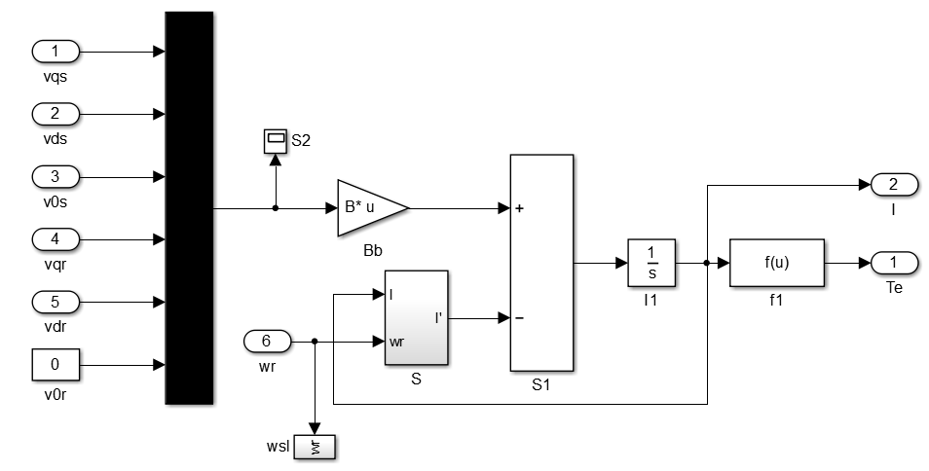
Induction Machine Model

Slide 13
Rotor Side Converter

Slide 14
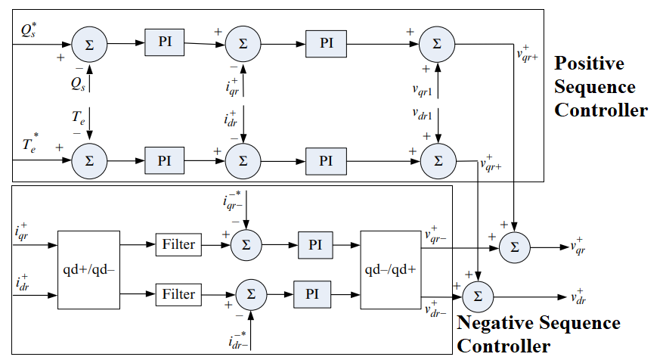
Rotor Side Converter

Slide 15
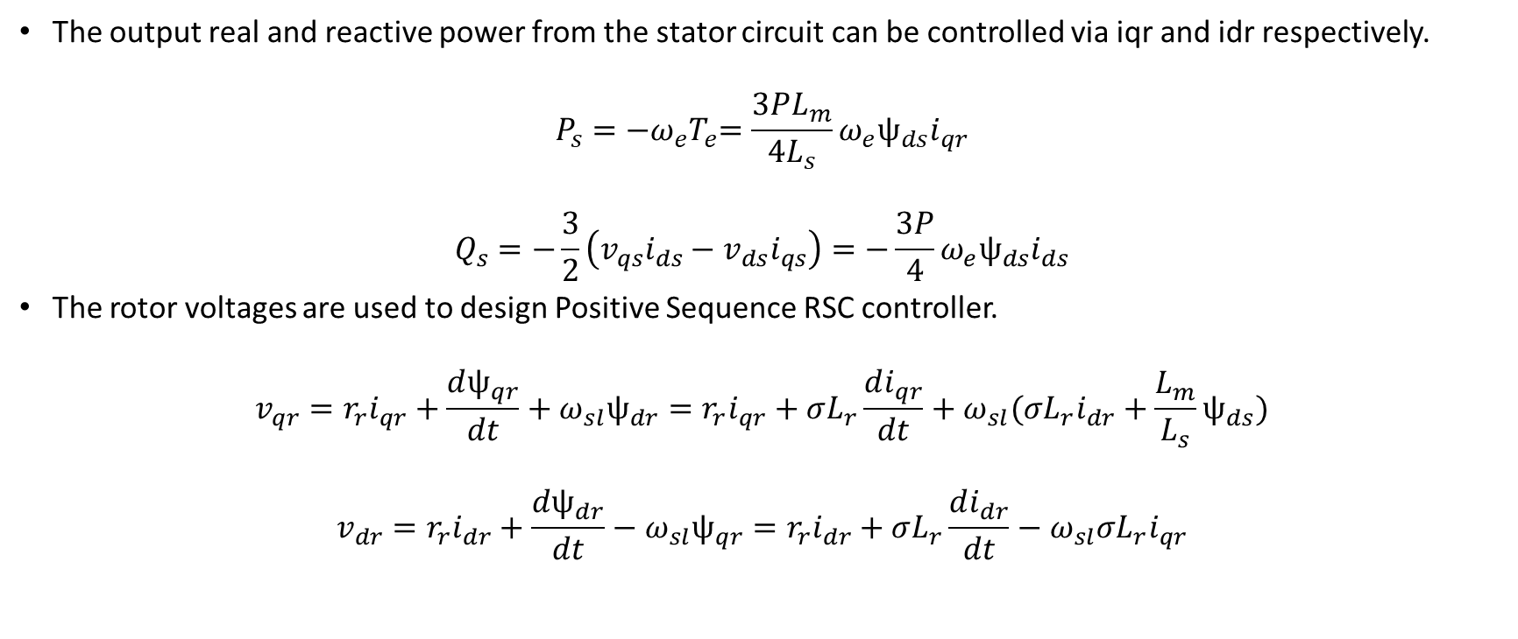
Rotor Side Converter Positive Sequence Controller
The output real and reactive power from the stator circuit can be controlled via iqr and idr respectively.
$$P_{s}={−ω_{e}T}_{e}=\frac{3PL_{m}}{4L_{s}}ω_{e}ѱ_{ds}i_{qr}$$
$$Q_{s}=−\frac{3}{2}\left(v_{qs}i_{ds}−v_{ds}i_{qs}\right)=−\frac{3P}{4}ω_{e}ѱ_{ds}i_{ds}$$
The rotor voltages are used to design Positive Sequence RSC controller.
$$v_{qr}=r_{r}i_{qr}+\frac{dѱ_{qr}}{dt}+ω_{sl}ѱ_{dr}=r_{r}i_{qr}+σL_{r}\frac{di_{qr}}{dt}+ω_{sl}(σL_{r}i_{dr}+\frac{L_{m}}{L_{s}}ѱ_{ds})$$
$$v_{dr}=r_{r}i_{dr}+\frac{dѱ_{dr}}{dt}−ω_{sl}ѱ_{qr}=r_{r}i_{dr}+σL_{r}\frac{di_{dr}}{dt}−ω_{sl}σL_{r}i_{qr}$$

Slide 16
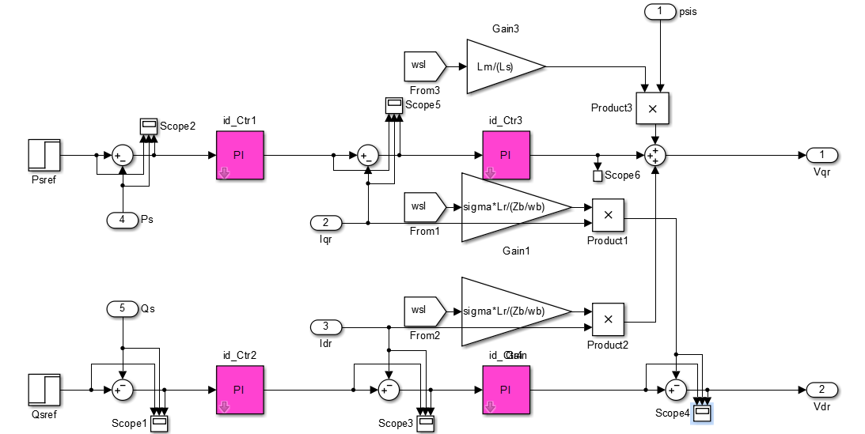
Positive Sequence Controller in RSC

Slide 17
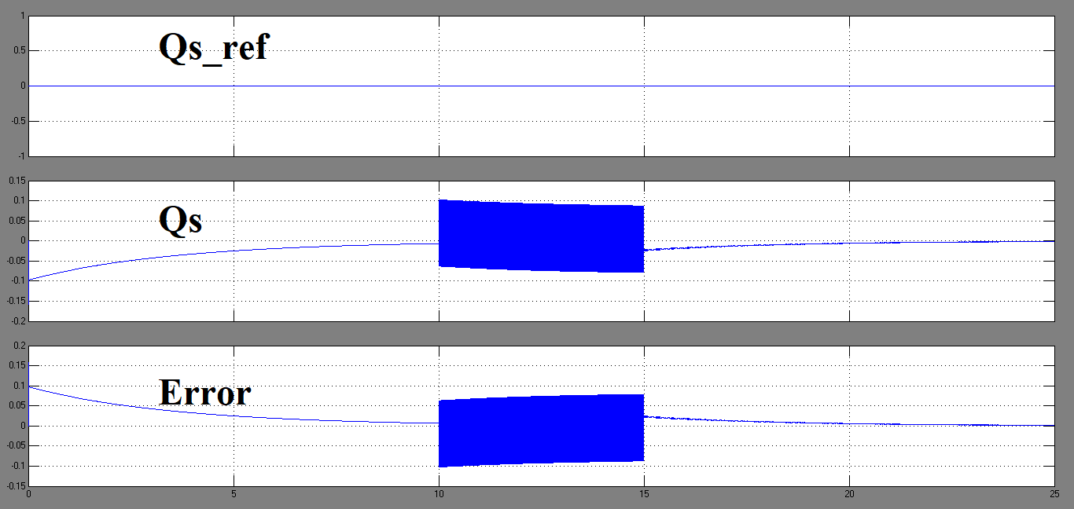
Positive Sequence RSC Control of Stator Power Qs

Slide 18
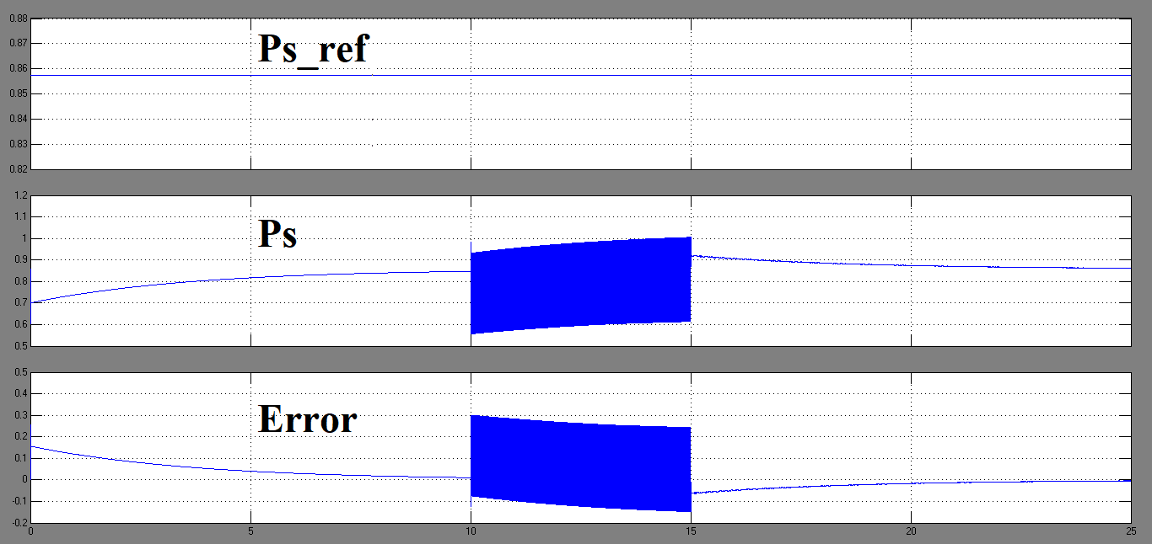
Positive Sequence RSC Control of Stator Power Ps

Slide 19
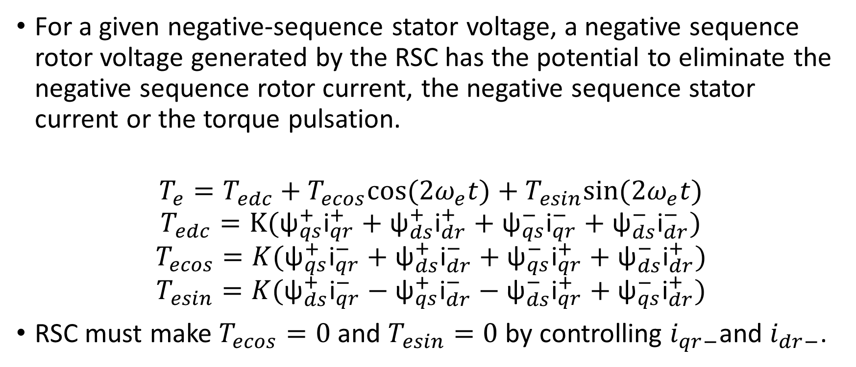
DFIG Rotor Side Converter Negative Sequence Control
For a given negative-sequence stator voltage, a negative sequence rotor voltage generated by the RSC has the potential to eliminate the negative sequence rotor current, the negative sequence stator current or the torque pulsation.
$$T_{e}=T_{edc}+T_{ecos}cos⁡(2ω_{e}t)+T_{esin}sin⁡(2ω_{e}t)$$
$$T_{edc}=K({\text{ψ}}_{qs}^{+}{\text{i}}_{qr}^{+}+{\text{ψ}}_{ds}^{+}{\text{i}}_{dr}^{+}+{\text{ψ}}_{qs}^{−}{\text{i}}_{qr}^{−}+{\text{ψ}}_{ds}^{−}{\text{i}}_{dr}^{−})$$
$$T_{ecos}=K({\text{ψ}}_{qs}^{+}{\text{i}}_{qr}^{−}+{\text{ψ}}_{ds}^{+}{\text{i}}_{dr}^{−}+{\text{ψ}}_{qs}^{−}{\text{i}}_{qr}^{+}+{\text{ψ}}_{ds}^{−}{\text{i}}_{dr}^{+})$$
$$T_{esin}=K({\text{ψ}}_{ds}^{+}{\text{i}}_{qr}^{−}−{\text{ψ}}_{qs}^{+}{\text{i}}_{dr}^{−}−{\text{ψ}}_{ds}^{−}{\text{i}}_{qr}^{+}+{\text{ψ}}_{qs}^{−}{\text{i}}_{dr}^{+})$$
RSC must make $T_{ecos}=0$ and $T_{esin}=0$ by controlling $i_{qr−}$and $i_{dr−}$.

Slide 20
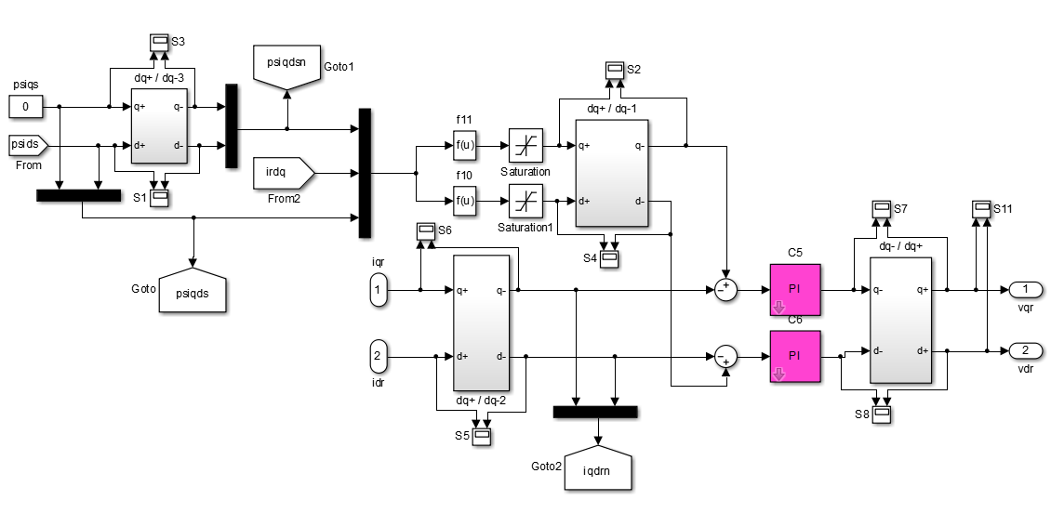
Negative Sequence Controller in RSC

Slide 21
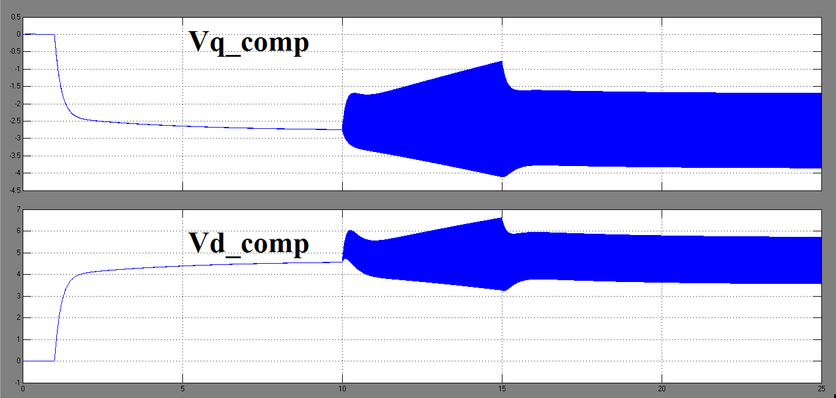
Negative Sequence Compensation via RSC

Slide 22
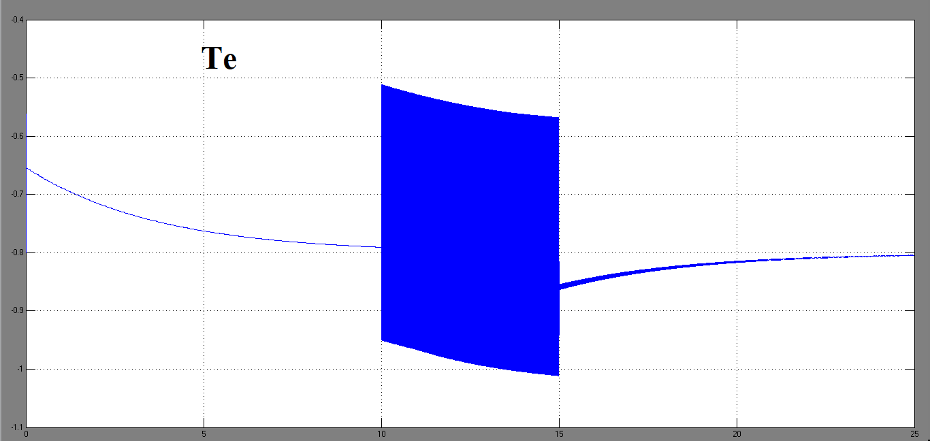
Torque Response

Slide 23
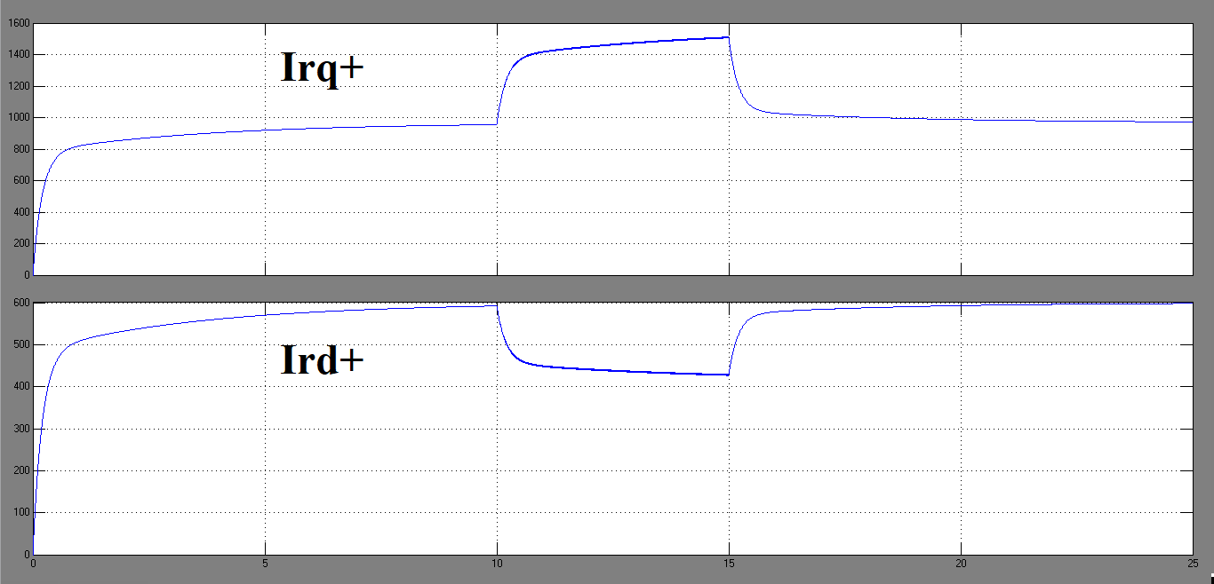
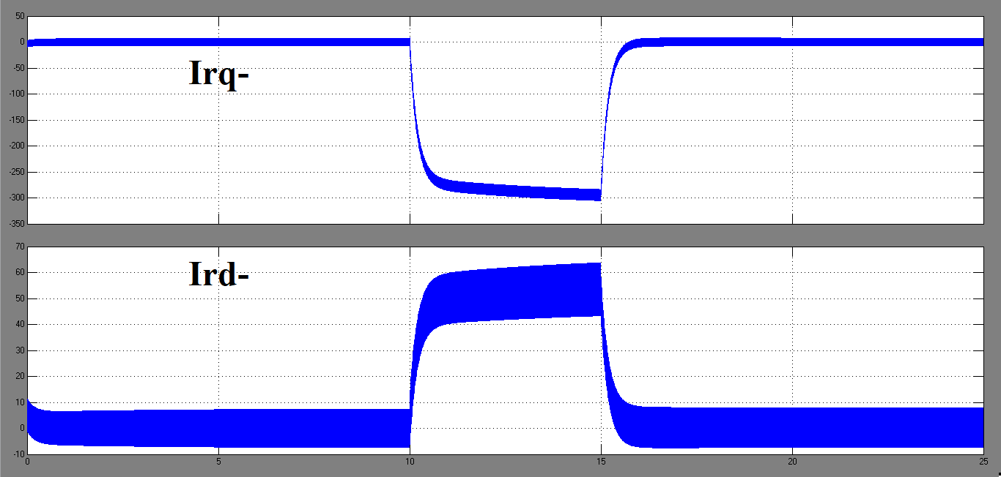
Rotor Currents

Slide 24
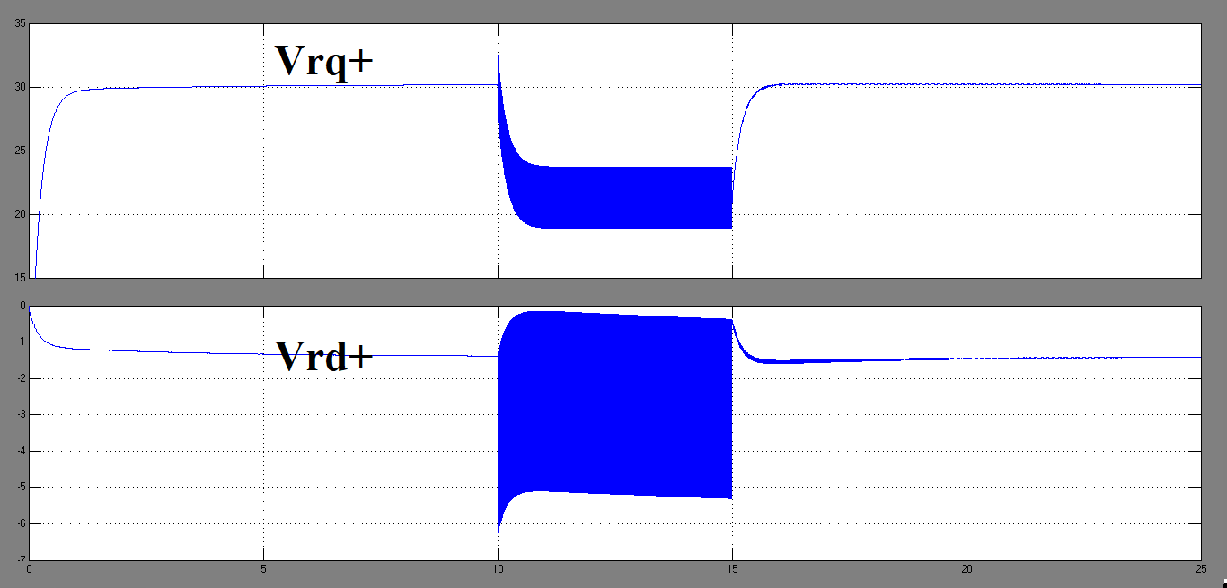
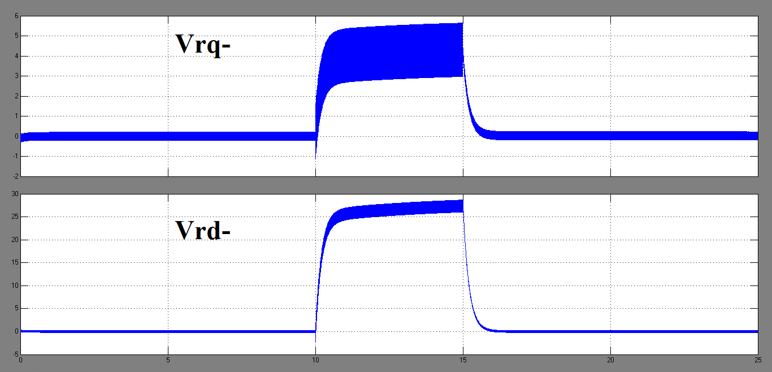
Rotor Voltages

Slide 25
Grid Side Converter

Slide 26
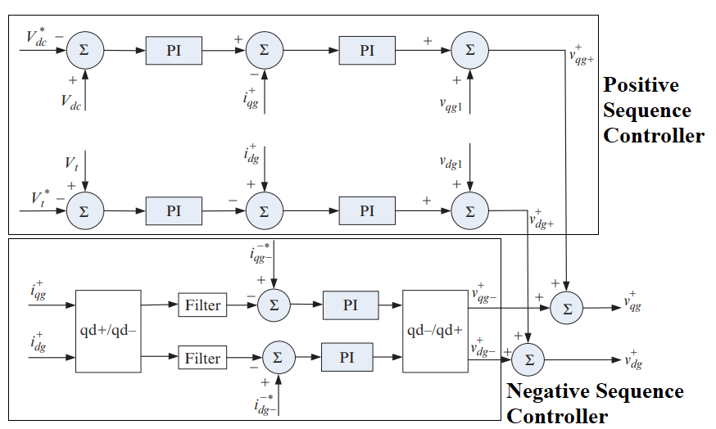
Grid Side Converter

Slide 27
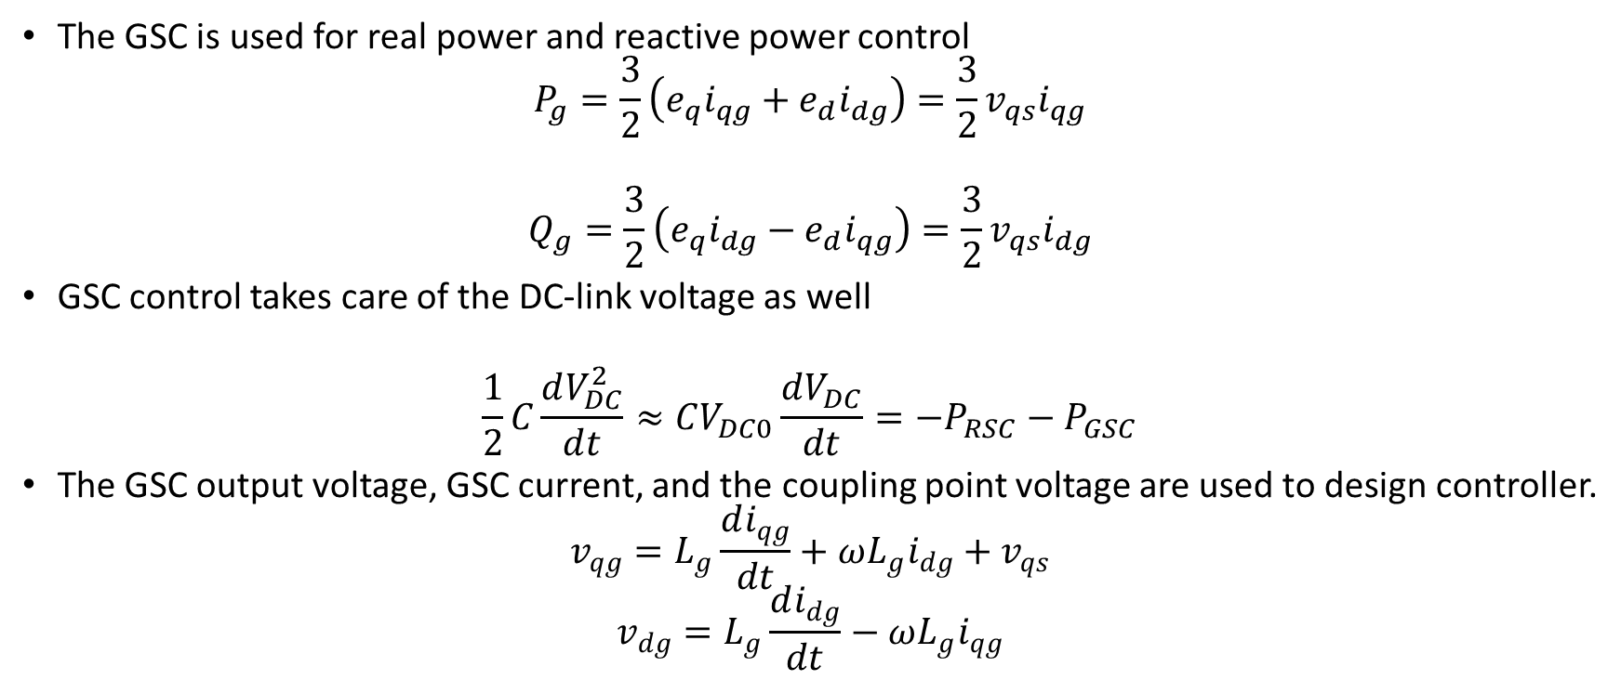
DFIG Grid Side Converter Positive Sequence Control
The GSC is used for real power and reactive power control
$$P_{g}=\frac{3}{2}\left(e_{q}i_{qg}+e_{d}i_{dg}\right)=\frac{3}{2}v_{qs}i_{qg}$$
$$Q_{g}=\frac{3}{2}\left(e_{q}i_{dg}−e_{d}i_{qg}\right)=\frac{3}{2}v_{qs}i_{dg}$$
GSC control takes care of the DC-link voltage as well
$$\frac{1}{2}C\frac{dV_{DC}^{2}}{dt}≈CV_{DC0}\frac{dV_{DC}}{dt}=−P_{RSC}−P_{GSC}$$
The GSC output voltage, GSC current, and the coupling point voltage are used to design controller.
$$v_{qg}=L_{g}\frac{di_{qg}}{dt}+ωL_{g}i_{dg}+v_{qs}$$
$$v_{dg}=L_{g}\frac{di_{dg}}{dt}−ωL_{g}i_{qg}$$

Slide 28
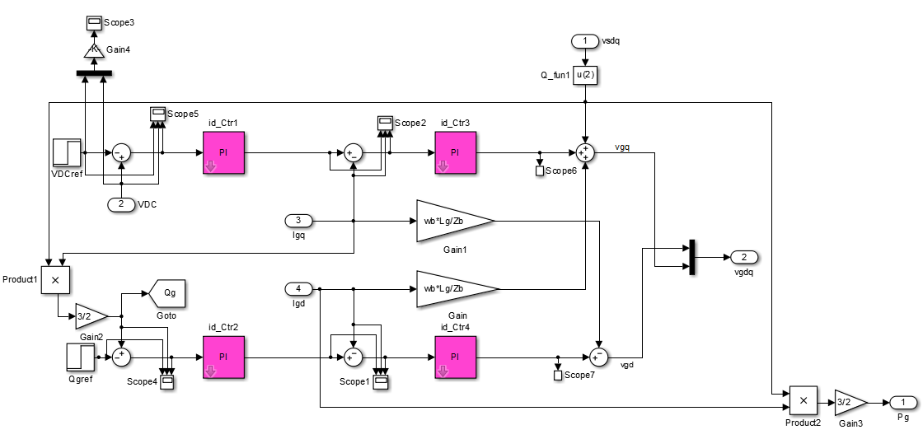
Positive Sequence Controller in GSC

Slide 29
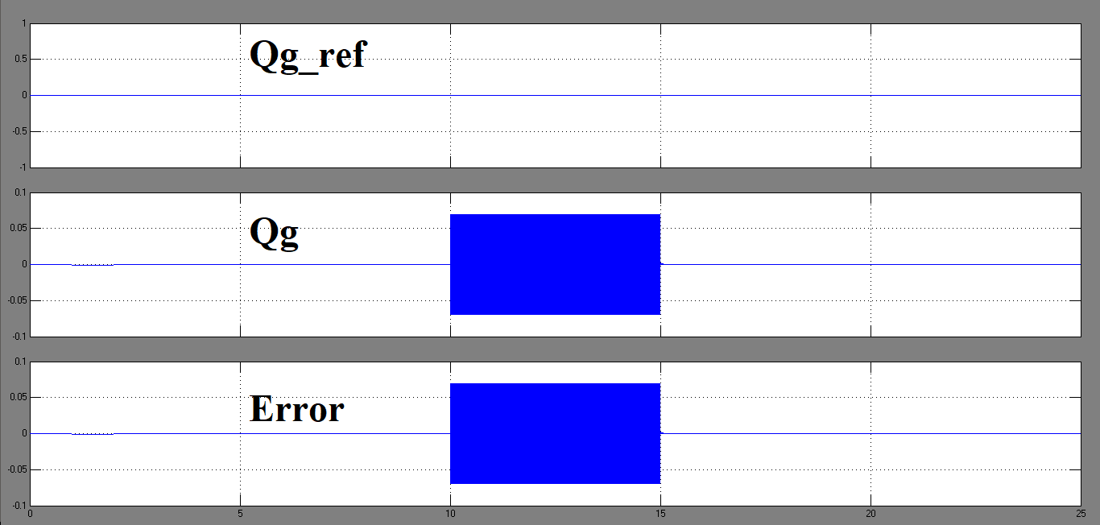
Positive Sequence GSC Control of GSC Power Q_GSC

Slide 30
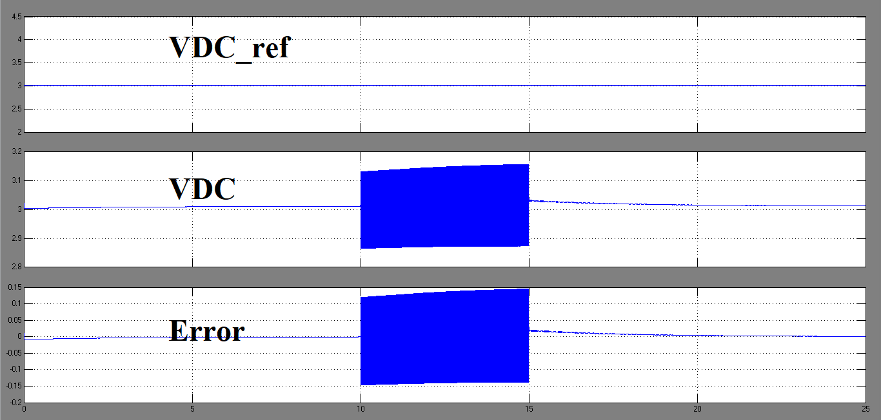
Positive Sequence GSC Control of DC Link Voltage VDC

Slide 31
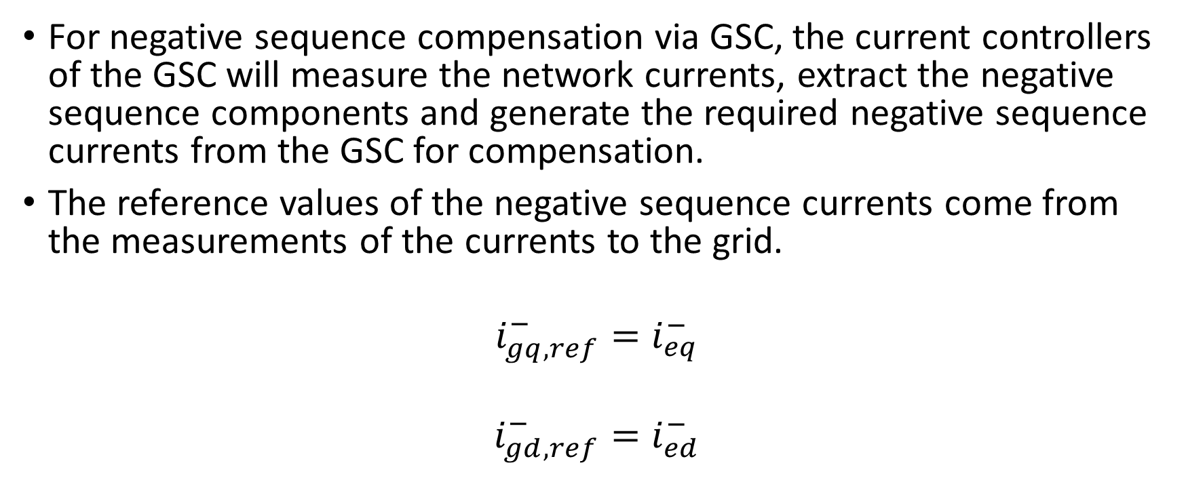
DFIG Grid Side Converter Negative Sequence Control
For negative sequence compensation via GSC, the current controllers of the GSC will measure the network currents, extract the negative sequence components and generate the required negative sequence currents from the GSC for compensation.
The reference values of the negative sequence currents come from the measurements of the currents to the grid.
$$i_{gq,ref}^{−}=i_{eq}^{−}$$
$$i_{gd,ref}^{−}=i_{ed}^{−}$$

Slide 32
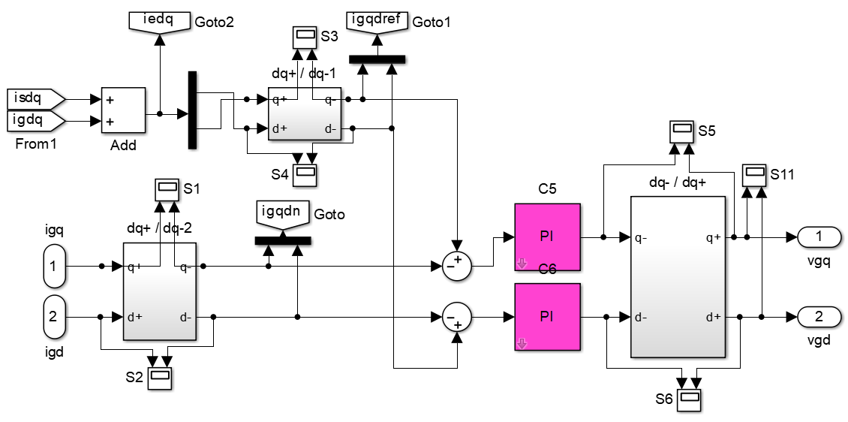
Negative Sequence Controller in GSC

Slide 33
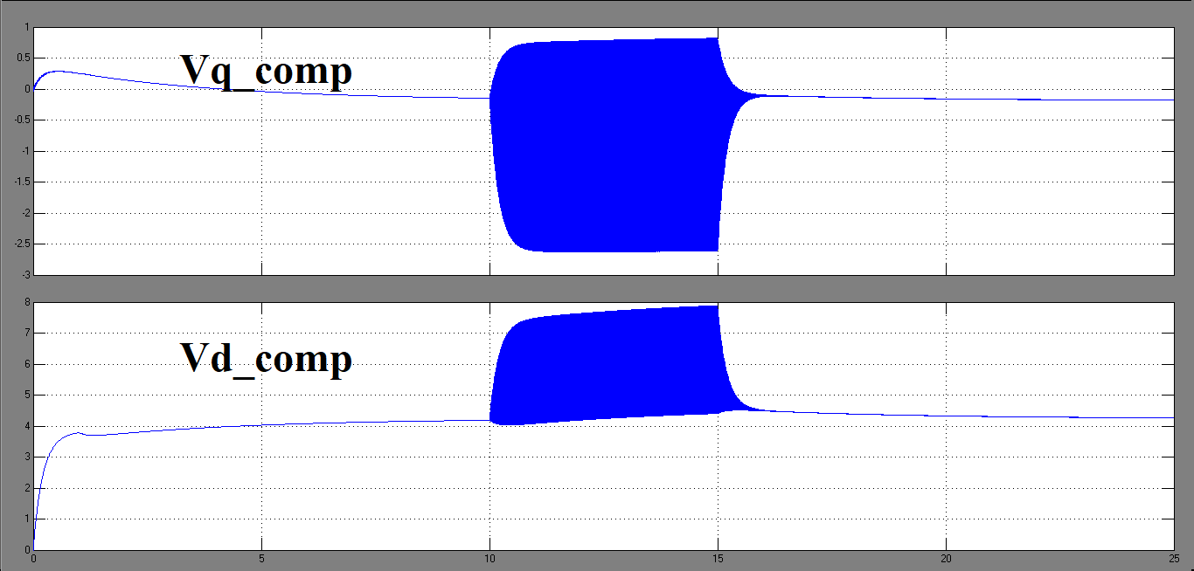
Negative Sequence Compensation via GSC

Slide 34
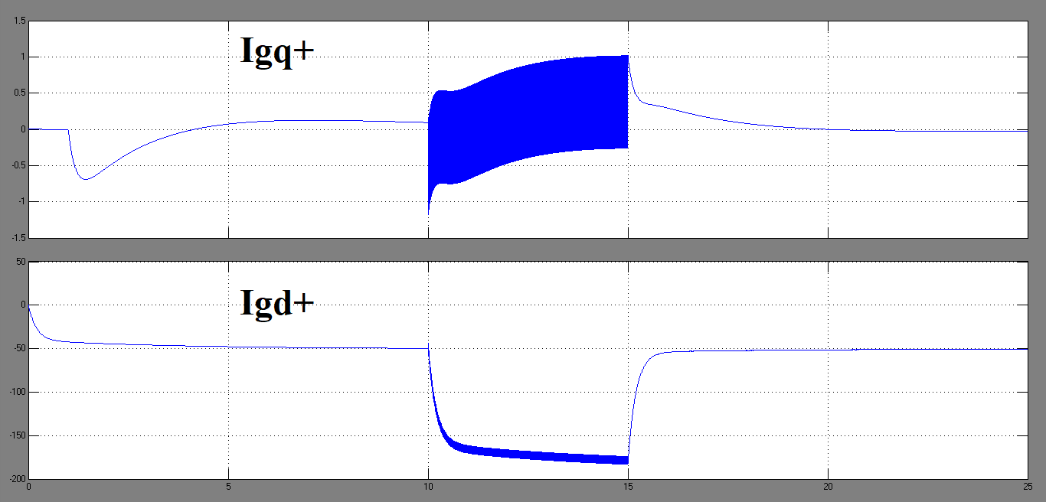
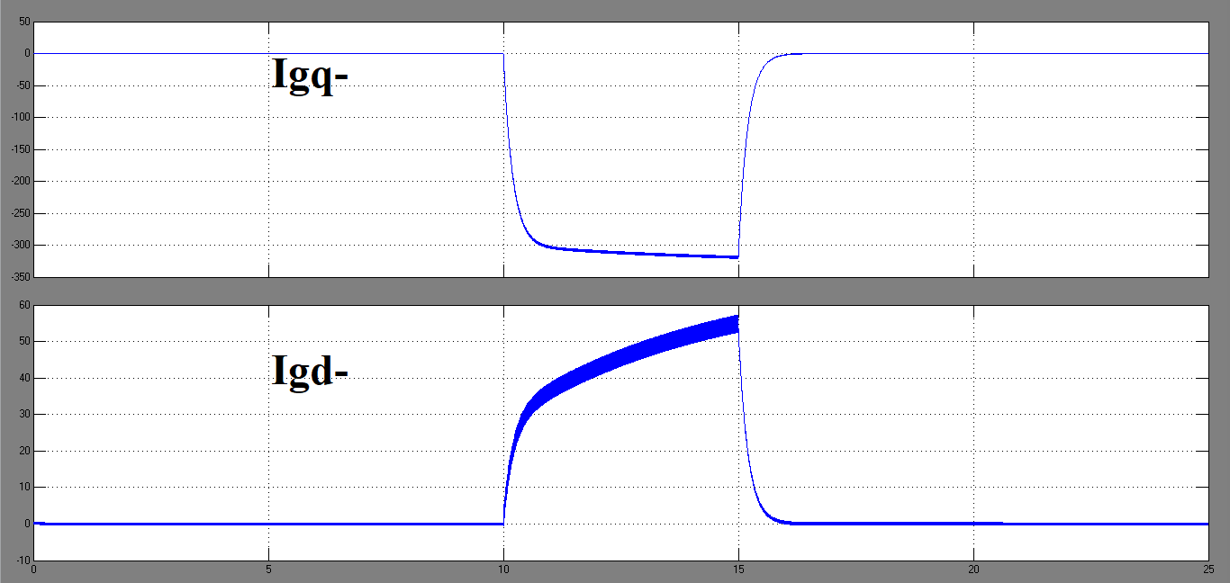
GSC Currents

Slide 35
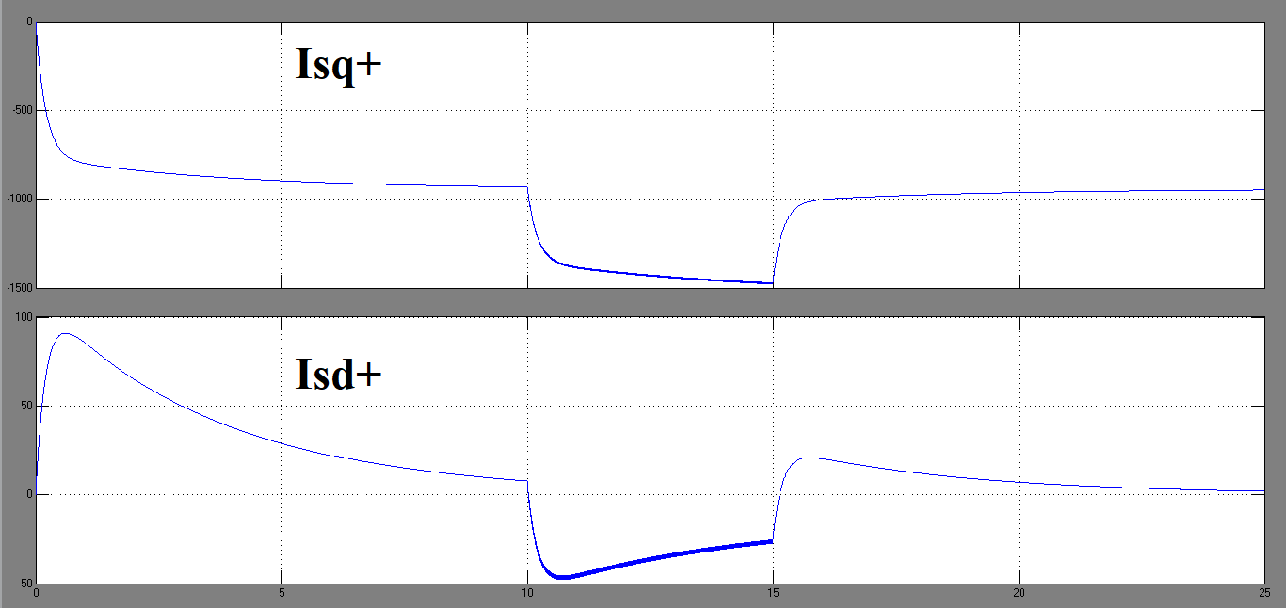
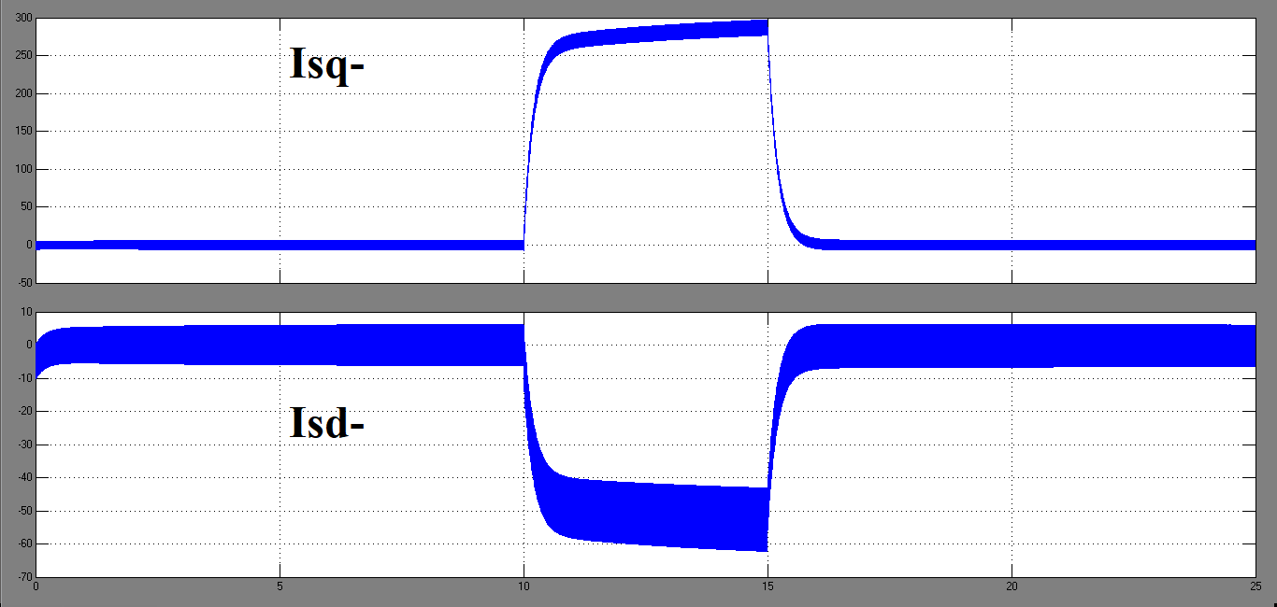
Stator Currents

Slide 36
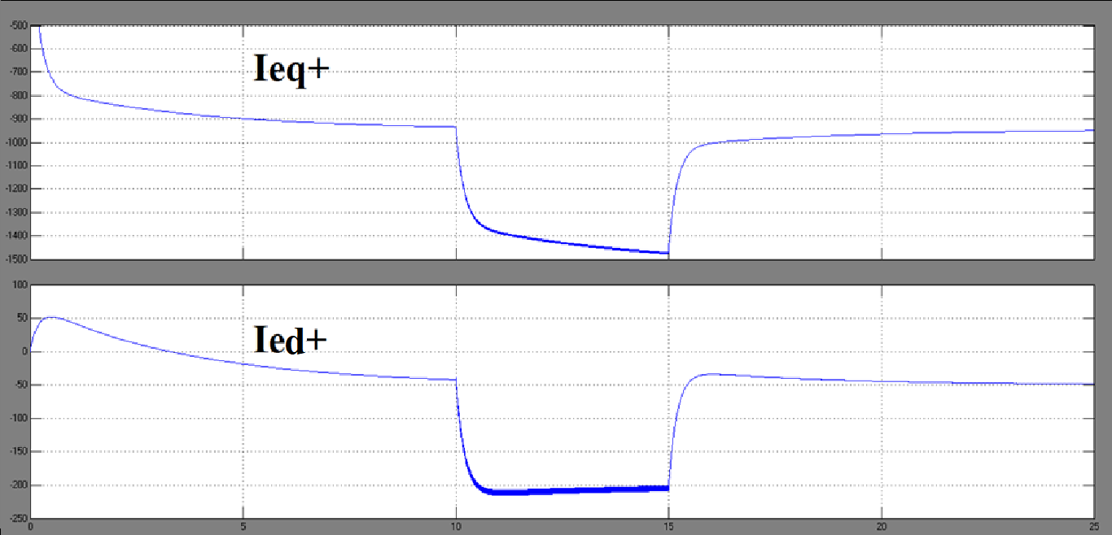
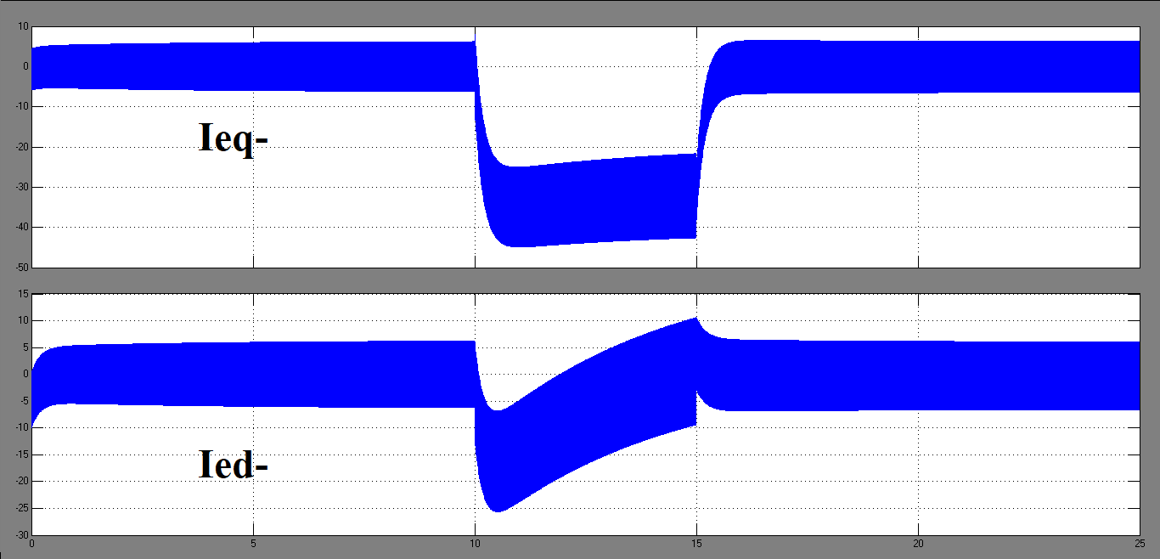
Grid Currents

Slide 37
Summary
Due to unbalanced stator voltage conditions, negative-sequence components in stator currents induce a high frequency component (ωe+ωm) or (2−s)ωe in rotor currents and pulsations at 2ωe frequency in electromagnetic torques.
GSC compensates the negative sequence currents required in the network during any unbalanced operation. It also controls Power delivered to grid by GSC and DC Link Voltage.
RSC has the potential to eliminate negative sequence rotor currents, negative sequence stator currents or torque pulsation. It also controls Active and Reactive Power delivered by stator.

Slide 38
References
L. Fan and Z. Miao, Modeling and Analysis of Doubly Fed Induction Generator Wind Energy Systems, Elsevier Ltd., 2015, 1-78.
R. Pena, J. Clare, G. Asher, Doubly fed induction generator using back-to-back pwm converters and its application to variable-speed wind-energy generation, IEEE Proc. Electr. Power Appl. 143(3), 1996, 231-241.
R. Pena, R. Cardenas, E. Escobar, Control system for unbalanced operation of stand-alone doubly fed induction generators, IEEE Trans. Energy Convers. 22(2), 2007, 544-545.

